Slide 1
Chapter No.4 Secondary Storage Devices

Slide 2
Magnetic Storage Devices

Slide 3
Magnetic storage Devices
Magnetic storage devices are the storage of data on a magnetized medium.
Magnetic storage uses different patterns of magnetization in a magnetized material to store data and is a form of non-volatile memory.
The information is accessed using one or more read/write heads.
Hard disks is widely used to store computer data as well as audio and video signals.

Slide 4
Magnetic storage Devices
Following are the examples of magnetic storage devices:
Hard Disc
Floppy Disc
Zip Disk
Magnetic Tapes

Slide 5
Hard Disc
Hard disks are manufactured in metal and coated with a magnetisable recording medium, similar to the material used in a floppy disk or audio tape.
A hard disk is a higher capacity medium, with up to hundreds of gigabytes.
Hard disks are much faster than floppy disks and can store much larger amounts of data.
They are usually non-removable, but removable hard disks are becoming more common.
They can be both read from and written to, and are the standard medium for storage on computer systems today.

Slide 6
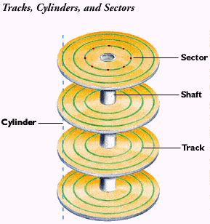
Hard Disc
It is normally supplied as a sealed unit and will often consists of a number of disks (platters) on a common spindle.
A hard disk is made up of Sectors, Tracks and Cylinders.

Slide 7
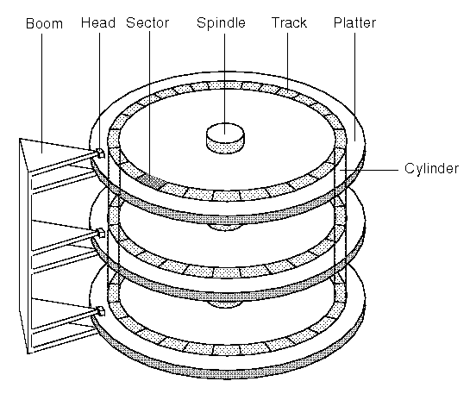
Hard Disc
Each disk is divided into tracks and sectors. Each sector can store between 256 and 512 bytes.
The tracks are immediately above and below each other. A particular set of such tracks is called a cylinder.
As the spindle turns the platters, the read/write heads move together in and out between the platters.
At any point in time they are all positioned over one particular cylinder

Slide 8
Hard Disc
It is now fairly standard for a pc to have a hard disk of at least 60GB. When PCs were first used in the 1980s, the hard disk’s capacity was measured in MB. But modern data and programs take up much more space especially as they are now GUI based.
Hard disks are pretty reliable
However as a standard they are fixed inside the systems unit/computer case.
Portable (removable) units are available though, and tend to be used mostly by laptop owners.
The specification of a hard disk depends not only on its capacity but also Access time to data. This is affected by the rotation Speed of the disk and also the way in which the disk is connected to the motherboard.

Slide 9
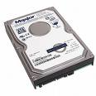
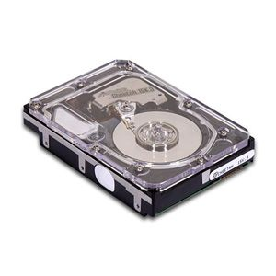
Hard Disc
The hard disk and the hard drive are packaged together.

Slide 10
Floppy Disc
A floppy disk is a low capacity disk which may be removed from the computer.
Data may be written to and read from a floppy. A small notch can be used to make the disk read-only.
Those holding a small amount of data (typically 1.44 Mb) And ‘Super floppies’ known as ZIP disks (typically 100 Mb)
Floppies have come a long way. There was the 8” floppy, and the 5¼” floppy, and then the 3½“ floppy.

Slide 11
Floppy Disc
The present floppy is a 3.5 inch magnetic disk of flexible material which typically stores 1.44 MB of data maximum.
The thin plastic circle is enclosed in rigid plastic to protect it.
A metal sliding access shutter opens when the disk is in the drive so that the read/write head can access the disk itself.
Data can be written to and read from a floppy disk.
A write protected Notch can be used to prevent accidental overwriting of data.

Slide 12
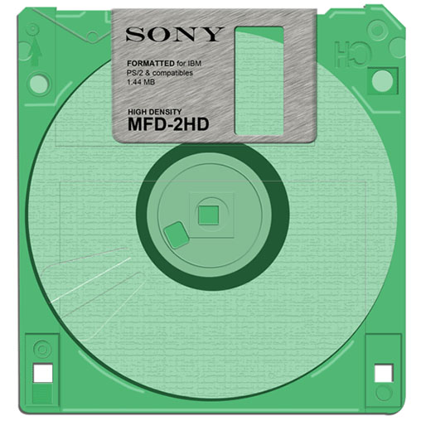
Metal Shutter
Plastic Jacket
Diskette
Write Protected Notch
Floppy Disc

Slide 13
Floppy Disc
They are small lightweight and easy to transport.
Ideal for backups of small amounts of data or for transfer of data from one machine to another.
Floppy Drives are common to most if not all computers.
On the down side, they may be easily misplaced, damaged or stolen.
There is a risk of transferring VIRUSES.

